Slide 1
Knowledge and Skills
Orientation –February,2010

Slide 2
Overview
K & S application is a central repository that maintains knowledge & skills data of all the employees in the organization.
The new K&S application workflow requires data to be captured in a structured way. The application is tabularized to that effect thereby; captures data in Category, Skill, Project, Certification & Foreign language tabs. Linking of Category to Skills is vital.
The Category has to be defined as Primary or Secondary. These categories should not be mistaken for Proficiency. You may have higher proficiency in skills representing Secondary Category but your Primary Category & skill could be different. For e.g.., you could be expert in Oracle but your Primary Category could be Java or DBA or Microsoft.
Skill details are further sub categorized into Technical , Functional & Behavioral data.
Project detail comprises of data of current project in Majesco as well as previous projects, which could be a part of past experience out side Majesco.
Certification detail comprises of technical certification like Microsoft, Java, etc.
Foreign Language detail comprises of languages like German, French, etc.

Slide 3
K & S Process Steps
Define Category / Domain*
Add and Assign Skills to defined Categories
Define Other details
Project Details
Certification
Foreign Language
Note : * Atleast one Primary Category needs to defined

Slide 4
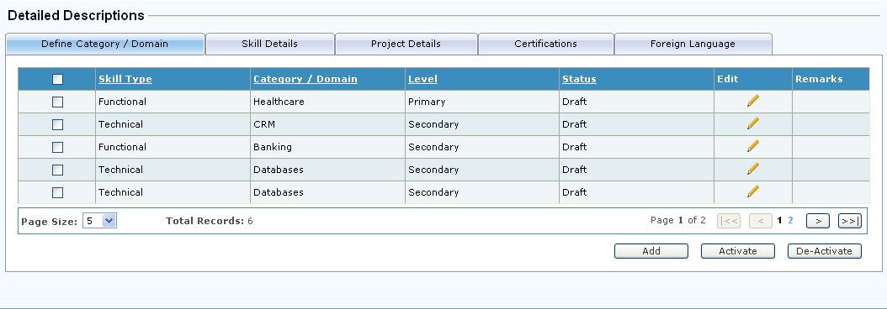
Knowledge and Skills - Main Page
The main screen, shown below, is the entry point for the employee to enter his/her K & S details and the following 5 tabs will be seen

Slide 5
Define Category / Domain
By default, the 1st tab i.e. Define Category will be displayed.
  Defining the Category is the first step in the entire process.
  Primary / Secondary definition is to be made at the “Category” level.
  Employee needs to define his / her Primary and Secondary category in case of Technical or Functional areas.
  There can be only one Primary category and multiple Secondary categories.
  Employee needs to define only one Primary category in Technical or Functional area.

Slide 6
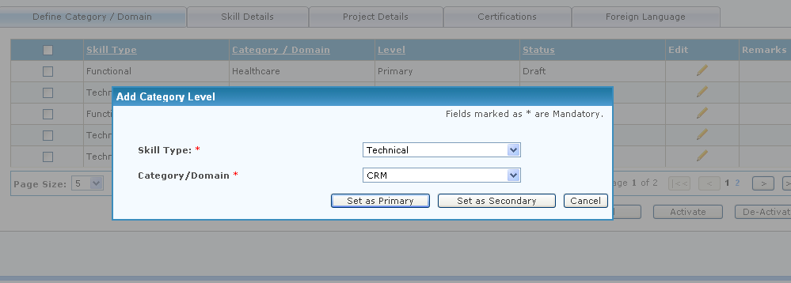
Define Category / Domain screen
Screen to add new records or edit existing records

Slide 7
Skill Details
Expand the 2nd tab – Skills Details to enter the Technical , Functional or Behavioral Skills
  Ensure that the Category which is defined as Primary and Secondary in the previous tab has a skill associated.
  As per the new Skill Taxonomy , Category is the highest level in the hierarchy in the Technical and Functional skills
  Category is followed by Sub Category and Skills.
  In case of Functional Skills, this is called as Domain , Sub Domain and Function.
  The 3 level the hierarchy is not applicable for Behavioral Skills. In this case it is Category and Skills only.
  Click the ‘Add Skill’ button
  Enter the required information like Category/ Domain, Sub Category/ Domain, Skill / Function, Proficiency, Experience , Type of Work (For Technical only) and Certification.
  Only the Approved Certifications will be available for selection. There can be multiple certifications attached to a skill.
  Save the details entered.
  Repeat above steps add multiple details.
  Click ‘Edit’ button to Edit Skill entry.
  Enter skill to be search and click on “Find” button, it will open new pop-up widows where you can add multiple skill against entered skill.
  After entering / updating the necessary details, click ‘Send For Review’ button, to send all newly added active Knowledge & Skill details to manager for approval.

Slide 8
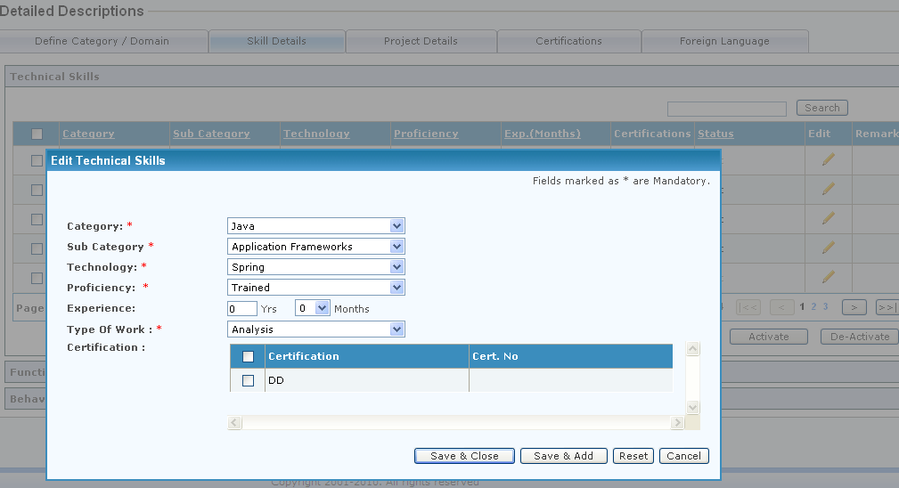
Skill Details screen
Screen to add new records or edit existing records

Slide 9
Project Details
Expand the 3rd tab – Project Details to enter the relevant details.
  Employee will input the current or the previous project details within Majesco or outside.
  Click the ‘Add’ button to add the project details.
  Enter the required information like Project, Role, Domain, Company Name, Execution Methodology, Project Category, Start Date , End Date and Client.
  Save the details entered.
  Repeat above steps to add multiple details.
  Click ‘Edit’ button to Edit Project details.
  After entering / updating the necessary details, click ‘Send For Review’ button, to send all newly added active Knowledge & Skill details to manager for approval.

Slide 10
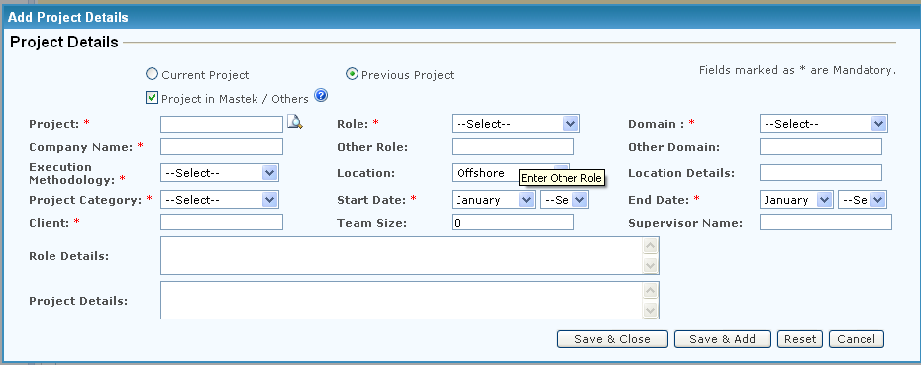
Project Details screen
Screen to add new Project details or edit existing one

Slide 11
Certification
4th tab – Certification is to enter the certification details.
  Employee will input his/ her Certification details.
  Click the ‘Add’ button to add the details.
  Enter the required information like Certification Name and Valid From date.
  Save the details entered.
  Repeat above steps to add multiple details.
  Click ‘Edit’ button to Edit Certification details.
  After entering / updating the necessary details, click ‘Send For Review’ button, to send all newly added active Knowledge & Skill details to manager for approval.

Slide 12
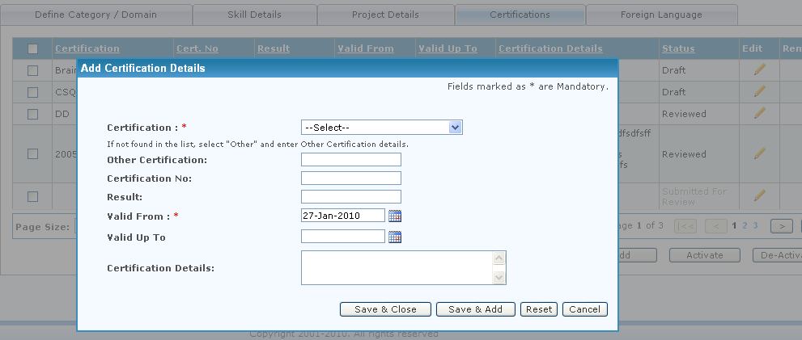
Certification screen
Screen to add new Certifications or edit existing

Slide 13
Foreign Language
  Expand the 5th tab – Foreign Language to enter details
    Employee will enter the Foreign Language which he / she knows.
    Click the ‘Add’ button to add the Foreign Language.
    Enter the required information like Language and the Proficiency
    Save the details entered.
    Repeat above steps to add multiple details.
    Click ‘Edit’ button to Edit details entered.
    After entering / updating the necessary details, click ‘Send For Review’ button, to send all newly added active Knowledge & Skill details to manager for approval.

Slide 14
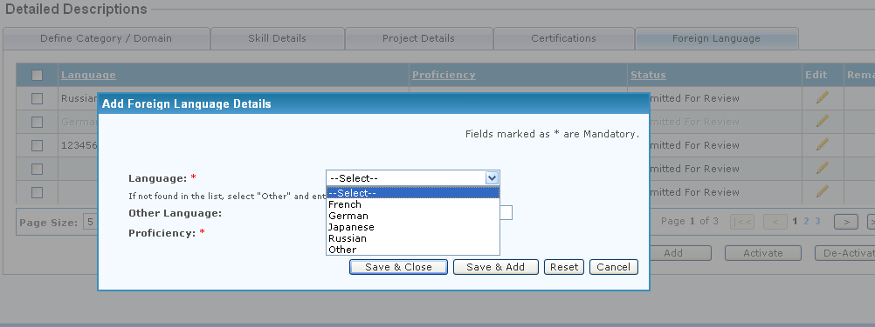
Foreign Language screen
Screen to add new Foreign Language or edit existing

Slide 15
Activate or De-activate K & S details
Expand the panel for which the detail has to be activated or de-activated i.e. Category / Skill / Project / Certification and Foreign Language details.
For de-activating details, select the record(s) through check box and click ‘De-activate’ button.
Deactivated record will be read only and grayed out.
For activating details, select the record(s) through check box and click ‘Activate’ button.
The deactivated records cannot be edited unless it is activated again.
*Note: By default, all newly added records are active in nature.
*Note: Active record(s) of any status can be seen by manager, while de-active record(s) cannot be.

Slide 16
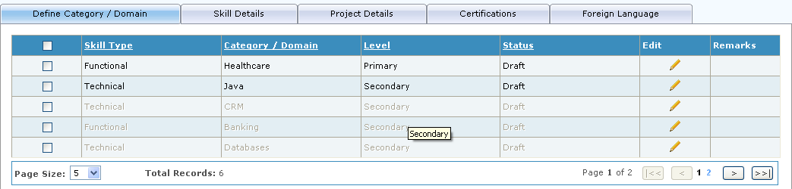
Activate or De-activate K & S details screen

Slide 17
Delegate rights for review and approval
Select employee(s) from team whose K & S details are to be delegated.
Select team subordinate to whom selected employee’s K & S details are to be delegated.
Click on the ‘Submit’ button.
*Note: Delegation allows manager to delegate the task of reviewing and approving the K & S details entered by the team members of the same project to selected subordinate. Assigned delegation can also be removed or reassigned.

Slide 18
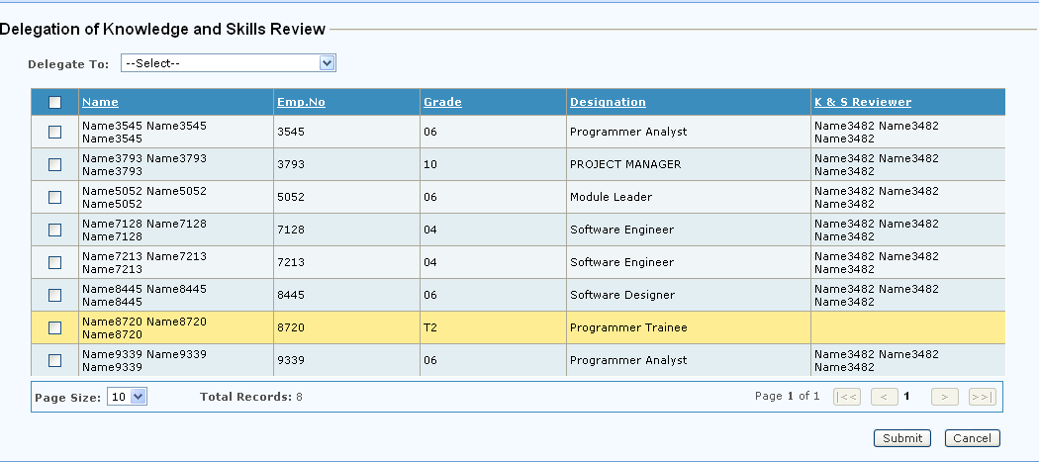
Delegation screen

Slide 19
FAQs (1)
Q) What do I do when I am on the default page of Knowledge & Skills application?
Ans. Your reviewed skills have been mapped to standard categories. These categories have been listed here. Identify which amongst these categories is your Primary current work area.
Q) I do not see any Category listing on the default page of K&S
Ans. You have to define your categories and related skills afresh. You would not have defined any skills in the previous version of K&S
Q) Can I add multiple Categories and Skills
Ans. Defined Categories have to be unique – duplicates are not expected. Skills are directly mapped to Categories and are added under defined categories only.
Q) What is a level? How may levels can I define.
Ans. Level defines Primary or Secondary area of work relating to skill or role. It must not be confused with Proficiency. There can be only One Primary and multiple Secondary levels defined.

Slide 20
FAQs (2)
Q) How do I view review comments?
Ans Click on image link under the Remarks columns to view Review comments from your manager
Q) How do I change my recorded entry
Ans Click on the image link under the Edit column to change data. Any previously approved and \ or reviewed data will change to Draft mode.
Q) I see only 5 records by default where are others?
Ans Click on the Page Size of the bottom left pane of the tabularized window to view additional records or use navigation icons on the right hand side pane.
Q) Can I deactivate a Reviewed Category or Skill and add a fresh one?
Ans. No. You have to activate the de-activated category or skill.

Slide 21
FAQs (3)
Q) When I add a Skill, I cannot see the Category I am looking out for.
Ans. Pls check the Category you are looking for could be disabled. You have to enable it. Alternatively, you need to add Category.
Q) I do not view the under Review column in other line items I can see it, what is the issue?
Ans. You have changed or added a new line item causing it to be displayed in a Draft mode. The icon will not appear in a Draft mode.
Q) I cannot map my Certification details to relevant Skills in the Skills section?
Ans. Certification can be mapped only after its approval and review.
Q) Can I add Primary and Secondary levels while adding Skills?
Ans. No. You can define levels only at a Category level

Slide 22
K & S System
Thank You!
If you have any queries or problems,
Please write to iishelpdesk@mastek.com

